Slide 1
Effects of providing teachers with two differently structured approaches of formative assessment
Larissa Aust; Jeanne-Celine Linker; Luise Eichholz; Jana Schiffer; Marcus Nührenbörger; Christoph Selter; Elmar Souvignier

Slide 2

1. Introduction

Slide 3
Formative Assessment
providing students with differentiated learning opportunities is a key competence for teachers (Kefallinou et al., 2020)
Formative Assessment (FA) = effective framework for providing adaptive, individualized teaching (Black & Wiliam, 1998; 2009; Schütze et al., 2018)
central components (Wiliam & Thompson, 2008)
assessing students’ achievement levels
providing feedback
adjusting instruction to students’ individual needs

Slide 4
FA and Professional Development (PD)
Evidence
positive effects on student achievement and motivation are well documented, especially for mathematics instruction (Aust et al., 2024; Hondrich et al., 2018; Klute et al., 2017; Lane et al., 2019; Lee et al., 2020)
Role of teachers
teachers are the key players in implementing FA into school practice and need a wide range of competencies (e.g., pedagogical content knowledge, data and assessment literacy) to successfully translate the broad concept into concrete classroom activities (Heitink et al., 2016; Lane et al., 2019; Schildkamp et al., 2020)
Role of PD
providing effective, ongoing and process-oriented PD is crucial for FA implementation (Lane et al., 2019; Lee et al., 2010; Sortwell et al., 2024)
tailored provision of knowledge accompanied by active learning opportunities, elaborated materials, and iterative cycles of input, implementation and reflection phases have been shown to be effective (Andersson & Palm, 2018; Heitink et al., 2016; Lane et al., 2019)

Slide 5
Research question
Little is known about…
how FA approaches and accompanying PD should be designed to make the concept accessible for teachers and support successful implementation
how teachers’ beliefs and professional behavior develop over the course of a PD program
→ direct comparison of different FA approaches and PD offers seems necessary
→ possible key variable: structure of the FA approach
Which are the effects of two differently structured FA approaches on teachers’ beliefs (acceptability, feasibility) and behavior (fidelity, sustainability) over the implementation process of one school year?

Slide 6
Hypotheses
Teachers’ perceptions and behavior are likely to be influenced by the realization and state of implementation:
highly structured approaches (Andersson & Palm, 2018; Hebbecker et al., 2022; Lane et al., 2019):
offer concrete guidelines for classroom activities
might facilitate initial implementation processes
more flexible approaches (Goertzen et al., 2023; Yin et al., 2008)
easier to adapt to the conditions at school, foster internalization processes
might benefit long-term implementation
→ Hypotheses:
higher ratings for the more structured approach compared to the less structured approach for the initial phase of implementation
equalizing ratings between the two approaches over time
no differences for sustainability at the end of the implementation period

Slide 7
2. Method

Slide 8
Formalization of the assessment component in this study
on-the-fly assessment
planned-for-interaction assessment (PI)
curriculum-embedded assessment (CE)
formalization of the assessment component
 | planned-for-interaction (PI) | curriculum-embedded (CE)
core instrument | focused conversations for assessment | written task sets for assessment
teachers’ tasks | considering in advance how to explore students’ learning levels, reflecting on different tasks’ diagnostic potential, developing further prompts | selecting and adapting tasks from a task pool and interpreting written documents
(Heritage, 2007; Shavelson et al., 2008)

Slide 9

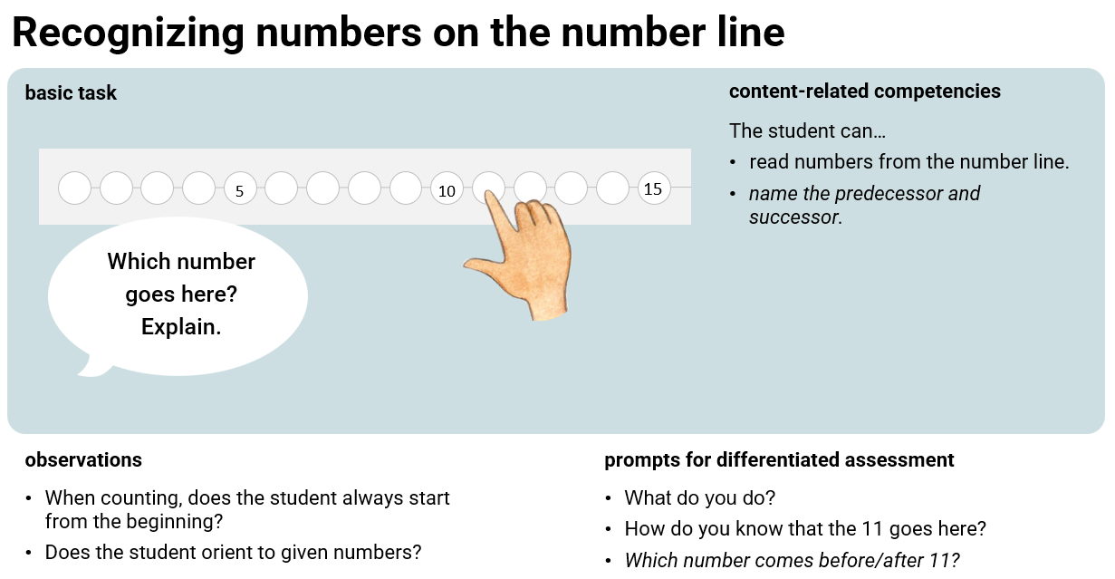
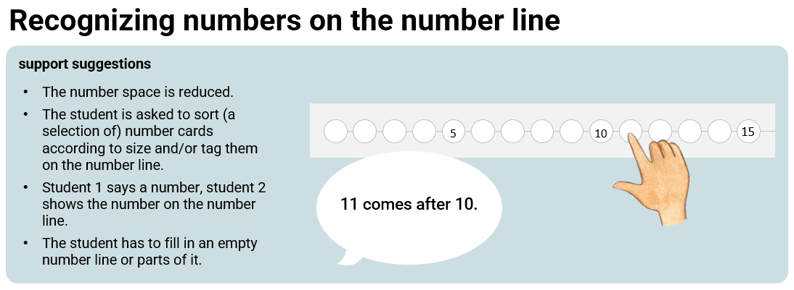
Example planned-for-interaction (PI)
teachers conduct the focused conversation for assessment with students they select using the set of cards for assessment
teachers use suggestions to provide targeted support

Slide 10

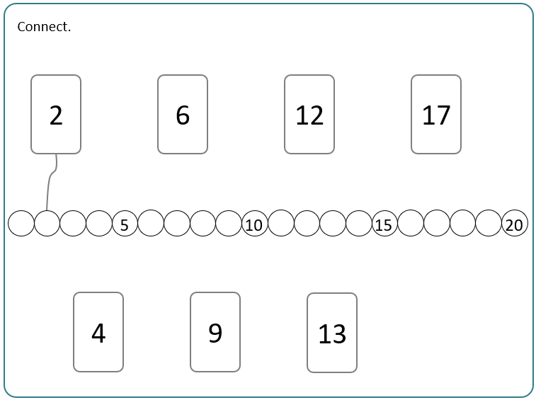
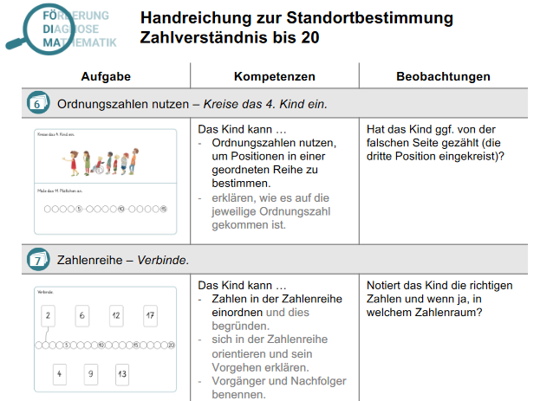
Example curriculum-embedded (CE)
all students fill out the written task set for assessment
teachers evaluate the assessments using a competency grid and evaluation table
teachers use suggestions to provide targeted support

Slide 11
Sample
N = 118 first- and second grade teachers from public school in mid-western Germany
95.6% female
age: M = 40.95 years (SD = 10.06)
teaching experience: M = 13.14 years (SD = 9.34)
education: 97.5% have studied elementary education (87.3% mathematics as a subject)

Slide 12
Design
professional development sessions (CE vs. PI) and conduction of practical tasks
09/2021
10/2021
12/2021
01/2022
03/2022
05/2022
understanding of numbers I assessment-based instruction
understanding of numbers II
using illustrative tools
understanding operations I
adapting tasks
understanding operations II
Encouraging communication
exploratory practice
providing feedback
securing practice
assessment-based instruction
teacher surveys
T1 acceptability, feasibility
T2-T6 acceptability, feasibility, treatment fidelity
T6 sustainability
(Aust et al., 2025; Nührenbörger et al., 2024)

Slide 13
Measures and data analysis
construct (range: 1 – 6) | no. of items | α | time points | sample item | data analysis
Acceptability (Meudt et al., 2020) | 3 | .86 to .96 | T1-T6 | I like the approach of the “FÖDIMA concept.” | hierarchical linear models for repeated measurment (measurement time points nested in persons) contrast effects and cross-level interactions treatment variable was dummy-coded (0 = CE, 1 = PI)
Feasibility (Meudt et al., 2020) | 4 | .84 to .89 | T1-T6 | The necessary preparations (copies, etc.) for implementing the “FÖDIMA concept” were feasible.
Fidelity (own scale) | 4 | .76 to .91 | T2-T6 | I used the assessment results to provide differentiated support.
Sustainability (adapted from Hebbecker & Souvignier, 2018) | 3 | .90 | T6 | I will continue implementing the “FÖDIMA concept” in the next school year. | Wilcoxon rank-sum test

Slide 14
3. Results

Slide 15


Results
CE
PI
Moderate to high levels of affirmative beliefs and professional behavior (scale: 1 – 6)
H₁: initial advantage for the more structured CE approach for all outcome variables (-.43 < g < -1.06)
H₂: decreasing differences for feasibility (-.04 < g < -.63), but quite constant differences for acceptability (-.58 < g < -1.01) and fidelity (-.38 < g < -.59)
sustainability:
H₃: higher mean values for CE (M = 5.0) compared to PI (M = 4.7), but this difference was not significant (z = 1.69, p = .091, r = .16)

Slide 16
4. Discussion

Slide 17
Discussion and Implications I
Successful implementation was facilitated to a greater extent by the more structured CE approach
When designing PD programs, concrete suggestions for classroom activities help teachers acquiring positive attitudes and translating the broad concept into teaching practice (e.g., Andersson & Palm, 2018; Hondrich et al., 2016).
practical considerations: application in whole-class setting (State et al., 2017)
→ To foster initial implementation it is crucial to provide teachers with clear guidelines and an explicit structure.

Slide 18
Discussion and Implications II
Only weak approximation of the ratings, slight decreases in self-reported beliefs and professional behavior
For the flexibility of the PI approach to pay off, even more implementation time might be required.
FA requires substantial changes in teaching activities and attitudes toward learning (Marshall & Drummond, 2006).
Implementing written task sets is easier than conducting PI-based conversations (that rely more strongly on teachers’ competencies) and thus might foster early positive experiences (Desimone & Garet, 2015).
indications of the beginning of catching-up effects?
Teachers might experience a “theory-practice-gap” when working with a comprehensive approach under real circumstances in school.
→ Providing ongoing teacher support with integrated reflection processes might foster long-term use.

Slide 19

Limitations and directions for future research
teachers’ evaluations of the concept and the circumstances under which it is implemented are likely to interfere → integrating other context variables (e.g., collective self-efficacy, principal’s support) might be fruitful
focus on teachers’ overall assessment of two differently structured approaches → studying possible interaction effects between the approaches and teachers’ individual prerequisites (i.e., teaching experience, knowledge) could be valuable → “differentiated PD” (Desimone & Garet, 2015)
direct comparison between two approaches → studying benefits of a combination of highly structured and more flexible elements
→ FA implementation as a long, multi-stage process in which teachers first need and explicit structure to initiate changes in classroom behavior and implementation then gradually becomes more flexible

Slide 20

link to publication
© illustrations by Karoline Mosen

Slide 21
Aust, L., Linker, J.-C., Eichholz, L., Schiffer, J., Nührenbörger, M., Selter, C., & Souvignier, E. (2025). How much formalization of assessment methods is useful when implementing formative assessment in second grade mathematics classrooms? Contemporary Educational Psychology, 81, 102376. https://doi.org/10.1016/j.cedpsych.2025.102376
Aust, L., Schütze, B., Hochweber, J., & Souvignier, E. (2024). Effects of formative assessment on intrinsic motivation in primary school mathematics instruction. European Journal of Psychology of Education, 39(3), 2177-2200. https://doi.org/10.1007/s10212-023-00768-4
Black, P., & Wiliam, D. (1998). Assessment and classroom learning. Assessment in Education: Principles, Policy & Practice, 5(1), 7-74. https://doi.org/10.1080/0969595980 050102
Black, P., & Wiliam, D. (2009). Developing the theory of formative assessment. Educational Assessment, Evaluation and Accountability, 21(1), 5-31. https://doi.org/10.1007/s11092-008-9068-5
Desimone, L. M., & Garet, M. S. (2017). Best Practices in Teachers’ Professional Development in the United States. Psychology, Society, & Education, 7(3), 252. https://doi.org/10.25115/psye.v7i3.515
Goertzen, L., Schils, T., & Heeneman, S. (2023). Co-designing formative assessment practices: A collaboration between elementary school teachers and researchers to conceptualize and implement formative assessment as a unified practice. Teaching and Teacher Education, 134, 104306. https://doi.org/10.1016/j.tate.2023.104306Andersson, C., & Palm, T. (2018). Reasons for teachers’ successful development of a formative assessment practice through professional development – a motivation perspective. Assessment in Education: Principles, Policy & Practice, 25(6), 576–597. https://doi.org/10.1080/0969594X.2018.1430685

Slide 22
Hebbecker, K., Meudt, S.‑I., Schütze, B., & Souvignier, E. (2022). Der Transfer von formativem Assessment in den Leseunterricht der Grundschule – die vermittelnde Rolle von Akzeptanz, Machbarkeit und Kooperation [Transfer of formative assessment in primary school reading lessons – the mediating role of acceptability, feasibility and cooperation]. Zeitschrift für Pädagogische Psychologie, 36(4), 248–262. https://doi.org/10.1024/1010-0652/a000279
Hebbecker, K., & Souvignier, E. (2018). Formatives Assessment im Leseunterricht der Grundschule – Implementation und Wirksamkeit eines modularen, materialgestützten Konzepts [Formative Assessment in third-grade reading instruction – Implementation and effectiveness of a modular concept including prepared teaching-material]. Zeitschrift für Erziehungswissenschaft, 21, 735-765. https://doi.org//10.1007/s11618-018-0834-y
Heitink, M. C., van der Kleij, F. M., Veldkamp, B. P., Schildkamp, K., & Kippers, W. B. (2016). A systematic review of prerequisites for implementing assessment for learning in classroom practice. Educational Research Review, 17, 50–62. https://doi.org/10.1016/j.edurev.2015.12.002
Heritage, M. (2007). Formative Assessment: What do teachers need to know and do? Phi Delta Kappan, 89(2), 140-145. https://doi.org/10.1177/003172170708900210
Hondrich, A. L., Decristan, J., Hertel, S., & Klieme, E. (2018). Formative assessment and intrinsic motivation: The mediating role of perceived competence. Zeitschrift für Erziehungswissenschaft, 21(4), 717–734. https://doi.org/10.1007/s11618-018-0833-z
Kefallinou, A., Symeonidou, S., & Meijer, C. J. W. (2020). Understanding the value of inclusive education and its implementation: A review of the literature. PROSPECTS, 49(3-4), 135-152. https://doi.org/10.1007/s11125-020-09500-2
Klute, M., Apthorp, H., Harlacher, J., & Reale, M. (2017). Formative assessment and elementary school student academic achievement: A review of the evidence. REL 2017-259. Regional Educational Laboratory Central. https://files.eric.ed.gov/fulltext/ED572929.pdf

Slide 23
Lane, R., Parrila, R., Bower, R., Bull, R., Cavanagh, M., Forbes, A., Jones, T., Leaper, D., Khosronejad, M., Pellicano, L., Powell, S., Ryan, M., & Skrebneva, I. (2019). Literature review: Formative assessment evidence and practice. In Australian Institute for Teaching and School Leadership (AITSL). https://www.lpofai.edu.au/media/u5ahfia0/literature-review.pdf
Lee, H., Chung, H. Q., Zhang, Y., Abedi, J., & Warschauer, M. (2020). The effectiveness and features of formative assessment in US K-12 education: A systematic review. Applied Measurement in Education, 33(2), 124–140. https://doi.org/10.1080/08957347.2020.1732383
Marshall, B., & Drummond, M. J. (2006). How teachers engage with Assessment for Learning: lessons from the classroom. Research Papers in Education, 21(2), 133-149. https://doi.org/10.1080/02671520600615638
Meudt, S.‑I., Zeuch, N., Neuber, L., & Souvignier, E. (2020). Kurzskalen zur Erfassung des Transfererfolgs von Leseförderkonzepten in der Schulpraxis [Short scales for assessing the transfer success of reading promotion concepts in school practice]. In K. Mackowiak, C. Beckerle, S. Gentrup, & C. Titz (Eds.), Forschungsinstrumente im Kontext institutioneller (schrift-)sprachlicher Bildung (pp. 141–157). Verlag Julius Klinkhardt. https://doi.org/10.35468/5801_08
Nührenbörger, M., Wember, F. B., Wollenweber, T., Frischemeier, D., Korten, L., & Selter, C. (2024). Development of teachers’ attitudes and self-efficacy expectations for inclusive mathematics instruction: effects of online and blended learning programs. Journal of Mathematics Teacher Education, 1-27. https://doi.org/10.1007/s10857-024-09624-8
Schildkamp, K., van der Kleij, F. M., Heitink, M. C., Kippers, W. B., & Veldkamp, B. P., (2020). Formative assessment: A systematic review of critical teacher prerequisites for classroom practice. International Journal of Educational Research, 103, 101602. https://doi.org/10.1016/j.ijer.2020.101602
Schütze, B., Souvignier, E., & Hasselhorn, M. (2018). Stichwort – Formatives Assessment [Keyword – Formative Assessment]. Zeitschrift für Erziehungswissenschaft, 21(4), 697- 715. https://doi.org/10.1007/s11618-018-0838-7

Slide 24
Shavelson, R. J., Young, D. B., Ayala, C. C., Brandon, P. R., Furtak, E. M., Ruiz-Primo, M. A., Tomita, M. K., & Yin, Y. (2008). On the impact of curriculum-embedded formative assessment on learning: A collaboration between curriculum and assessment developers. Applied Measurement in Education, 21(4), 295-314. https://doi.org/10.1080/08957340802347647
Sortwell, A., Trimble, K., Ferraz, R., Geelan, D. R., Hine, G., Ramirez-Campillo, R., Carter- Thuiller, B., Gkintoni, E., & Xuan, Q. (2024). A systematic review of meta-analyses on the impact of formative assessment on K-12 students’ learning: Toward sustainable quality education. Sustainability, 16(17), 7826. https://doi.org/10.3390/su16177826
State, T. M., Harrison, J. R., Kern, L., & Lewis, T. J. (2017). Feasibility and acceptability of classroom-based interventions for students with emotional/behavioral challenges at the high school level. Journal of Positive Behavior Interventions, 19(1), 26–36. https://doi.org/10.1177/1098300716648459
Wiliam, D., & Thompson, M. (2008). Integrating assessment with learning: What will it take to make it work? In C. A. Dwyer (Ed.), The future of assessment: Shaping teaching and learning (pp. 53-82). Erlbaum. https://doi.org/10.4324/9781315086545-3
Yin, Y., Shavelson, R. J., Ayala, C. C., Ruiz-Primo, M. A., Brandon, P. R., Furtak, E. M., Tomita, M. K., & Young, D. B. (2008). On the impact of formative assessment on student motivation, achievement, and conceptual change. Applied Measurement in Education, 21(4), 335-359. https://doi.org/10.1080/08957340802347845

